Slide 1
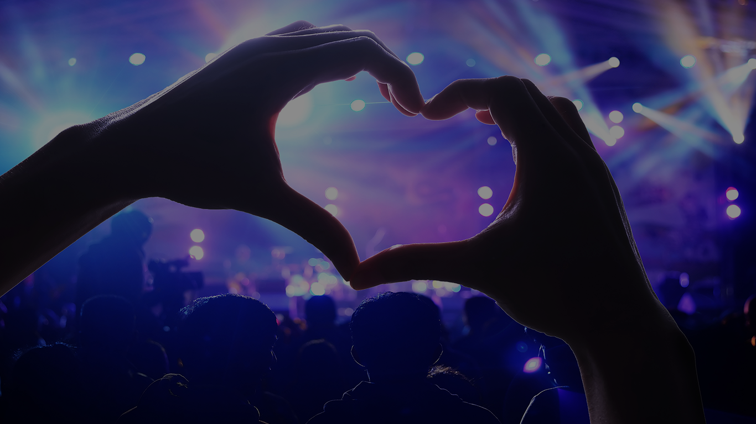

Slide 2
Today
Notes:
A little about me
Establishing credibility
A journey from the macro to the micro …
Then back again …
Then an audacious concept
Important for me to learn too though, interested inn questions and comments all day!

Slide 3
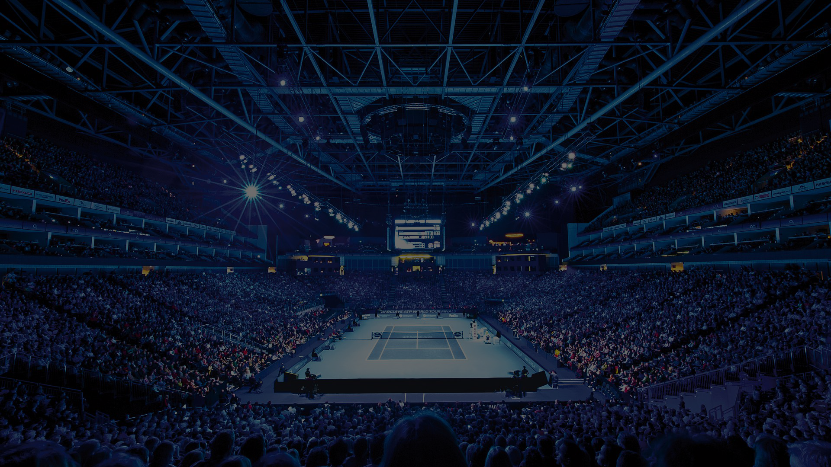
Establishing Credibility
Notes:
ILEA, and other industry associations (HBAA, MIA, MPI, BVEP, House of Commons, Visit Britain etc)
IBTM – China, Abu Dhabi, Mexico City
ICE – From Wellness to sustainability

Slide 4
‘Events are Good for Business’
‘Instability the new normal’
‘… a confident, growing industry, showing its value to business …’
Notes:
We need to track back further than 2018 and establish a long cycle of ecological, political and environmental uncertainty
Throughout which the events industry has flourished
Because of its symbiotic relationship with business
… and most importantly industry
However … (and not the first of the day …)

Slide 5
Reasons to be Cheerful

Slide 6
The meetings and events sweet spot
STEM
FinTech: $350bn industry
Notes:
The industries ability to prosper in terms of dynamic / growth industries
The importance of knowledge, education, community and communication
Remember: Growth = Communication; Consolidation = Communication; Regulation = Communication; Communication = meetings and events
Science, technology, engineering & mathematics
Underline the importance of taking a wider view of industry e.g. Construction, Finance, ITC, Pharma, Automotive
They pay for the events!
Symbiotic relationship between growth industries and the meetings and events industry

Slide 7
AutoTech
Notes:
Going to look a little bit more at some of the key industries that affect this market place
Understand that some of these industries are part of Hyatt's own industry targeting strategy
Trend: IndTech – the combining of industries to create industries
AutoTech; electric cars, driverless cars etc.
‘The movement of people’
The Fault in our Cars .. The Economist
Long supply lines etc.
The same as curing lung caner (UK specific)
Talk more about how this will directly affect day to day meetings later

Slide 8
PharmaTech
Notes:
Pretty much everyone will know the importance of the pharma market to the industry
Speeding up of sector growth to +6% between 2018 and 2024
Expansion driven by ‘Orphan Drug’ market, $262 billion in 2024

Slide 9
Notes:
- So, what does this all mean on a more micro basis?

Slide 10
Brexit equals
Delay UK
Notes:
Constantly asked about Brexit
This is a personal opinion … built on lots of research
If organisers / businesses can delay / cancel an event, they will
Especially in a struggling economy
There are precedents; elections, Olympics etc.
Talk more about how the industry takes this on a little later

Slide 11
Incentives are exciting
Two thirds of incentive travel includes meetings
Transformative Travel
Authentic experiences
Wellness 2.0
Notes:
Massive growth in global incentives market
Confidence in incentives to make a difference, combined with business growth: Good for Business
China to Scotland / Indonesia to Melbourne
More and more including a meetings element
Understand the trickle down of major incentive travel
Three trends for this market
Transformational Travel: ‘from ‘beach resorts’ to enriching, cultural experiences
Authentic experiences
Wellness … more on this later

Slide 12
Association Meetings are dynamic
From STEM to SMERF
IndTech & London Tech Week
Notes:
Underline the dynamism of this sector
STEM: Science, technology, engineering, mathematics
SMERF: Social, Military, Educational, Religious, Fraternal Groups
London Tech Week, non traditional model
Destination working with organiser / PCO; not association working with PCO

Slide 13
Wellness 2.0
Merging sustainability, authenticity and wellness
Notes:
Mention ICE survey 2018
Mow sustainability and wellness are merging
Why is this important
Next gen is more likely to leave a job for ethical reasons than financial and career reasons
This is about people enjoying their lives
We need to be aware of this ‘new’ kind of delegate
A great event has to have a great culture to attract ‘new’ minded delegates
Sustainability / authenticity / wellness, are all intertwined
Sustainability; vegan food, plastics, water etc.
This will put financial pressure on venues
What is easier to cancel? The end of the corporate junket?
A sign of the industry justifying itself

Slide 14
Smaller session sizes
Lead time convergence
Convergence of meeting type
Roadshows
Notes:
Micro trends
smaller session sizes, sign of a millennial generation?
lead time convergence – specific within the Christmas Party Market, but equally relevant to the mid sized meeting market
meeting type convergence
Growth of Roadshows?

Slide 15
Encourage certainty
Notes:
Prudential case study
Increasing share price
Being certain, definite
An event is a point in time
Events are tangible where other communication mediums are not

Slide 16
The Experience Economy
Notes:
Harvard paper created in 2007
Cake: Agricultural, Industrial, Commercial … Experience
Four key areas convergence
Economic: generation rent
Digital: Symbiotic nature between events and digital campaigns; the need for triggers
The need for many brands to have a physical contact; Amazon creating book shops; immersive worlds
People’s need to ‘touch’; shared experiences
Value in experience vs events: 90% - 10%
Live Group example

Slide 17
Festivalisation
Listening events
A new age of ‘dynamic’ event professionals
Notes:
Festivalisation
Listening events
A new age of dynamic event professionals

Slide 18
The Future

Slide 19
Smart Cities with smart infrastructure
Driverless cars
Alexa
Notes:
Smart Cities with smart infrastructure;
5G stat
$34+ bn spent on 88 smart cities by 2025
like a venue without wifi …
The fault in our cars …
Movement of people
Plenary meetings
Food, exercise
Transport of goods (like airlines)
Amazon Alexa a s way finders

Slide 20
The Edge of Chaos

Slide 21
